Slide 1
Which Neighborhood in Atlanta is Best for a Metal Music Venue Business? Considering Transportation, Demographic, and Urban Planning Factors
Tingyu Liu

Slide 2
Index
3 Topic and Objectives
4 Method & Tools
5 Data Used
6 Competitor Analysis
7 Transport Analysis
9 Demographic Analysis
10 Factor Integration
11 Restriction Analysis
12 Final Selection
13 Conclusion and Discussion
14 Reference

Slide 3
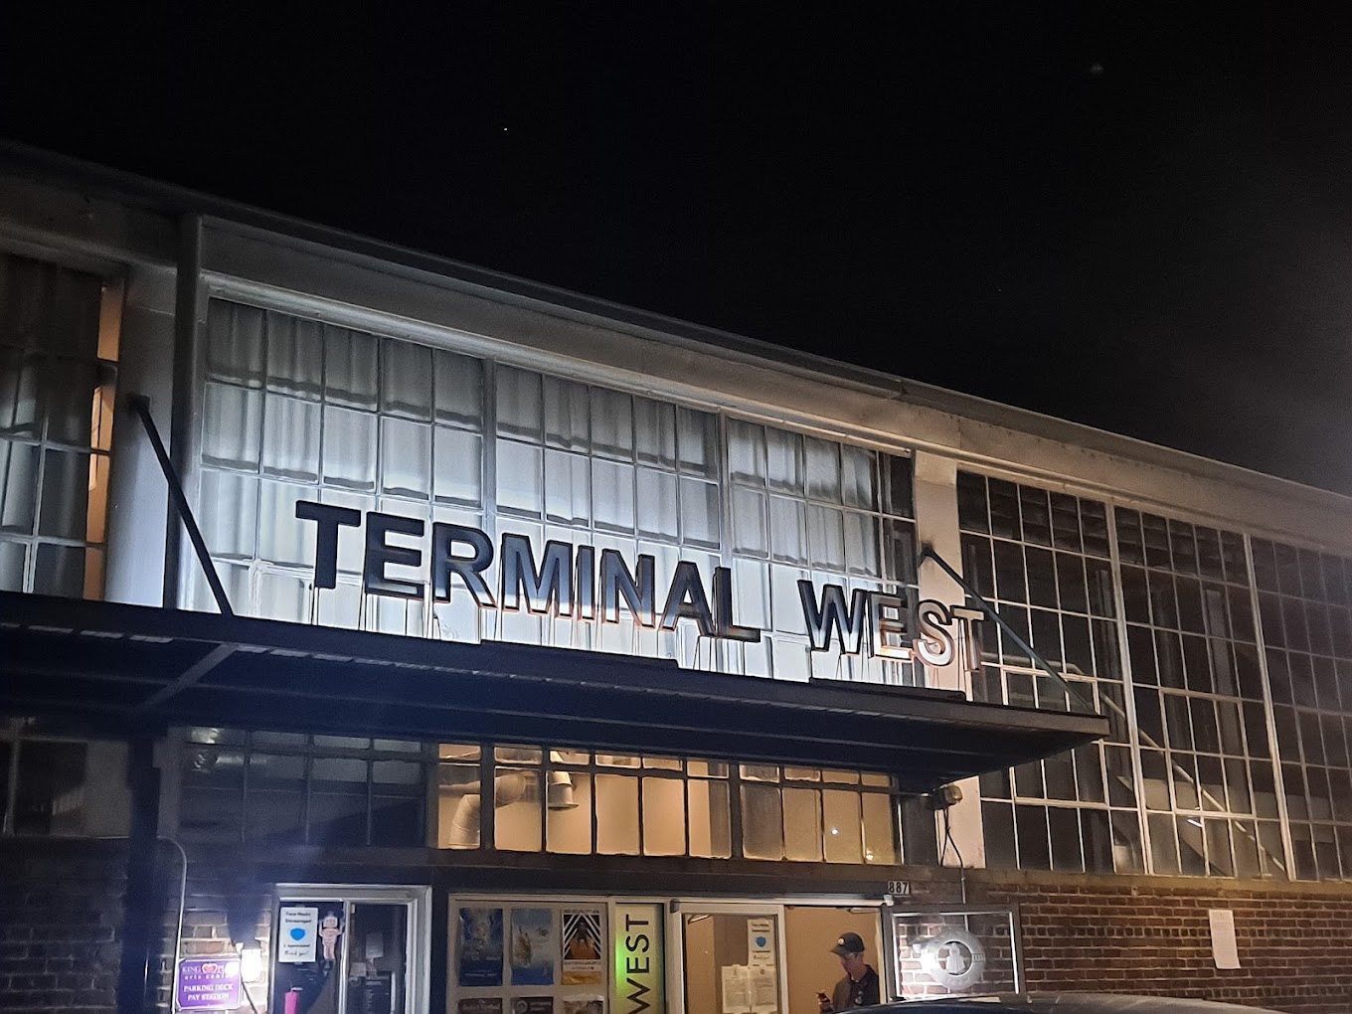
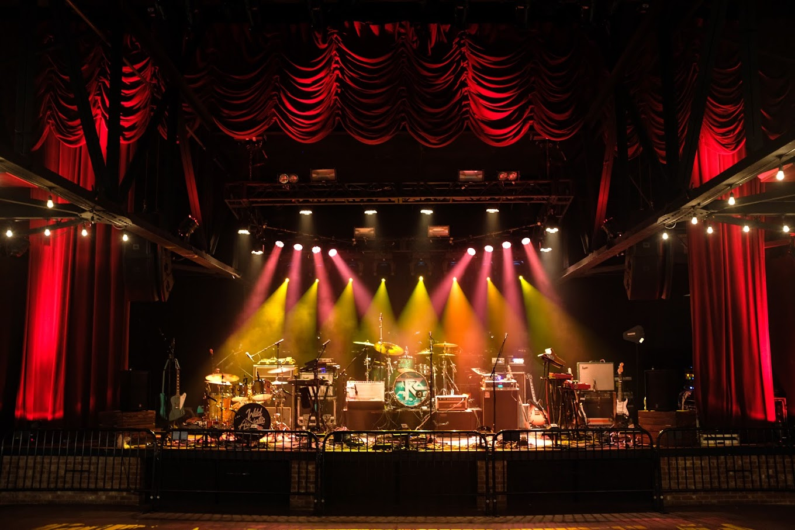
Topic and Objectives
Evaluate the accessibility to current music venues.
Identify neighborhoods with high potential for establishing music venues, considering transport, demographic, and urban planning factors.
Contribute to promotion of a vibrant music scene in Atlanta.

Slide 4
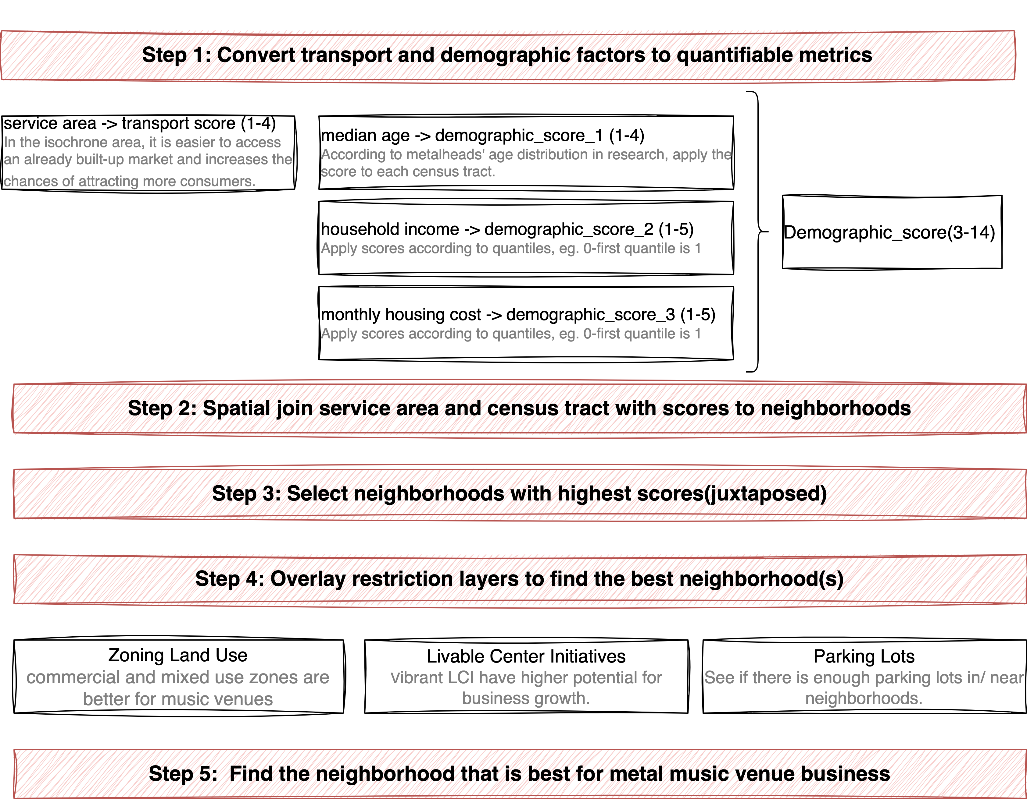


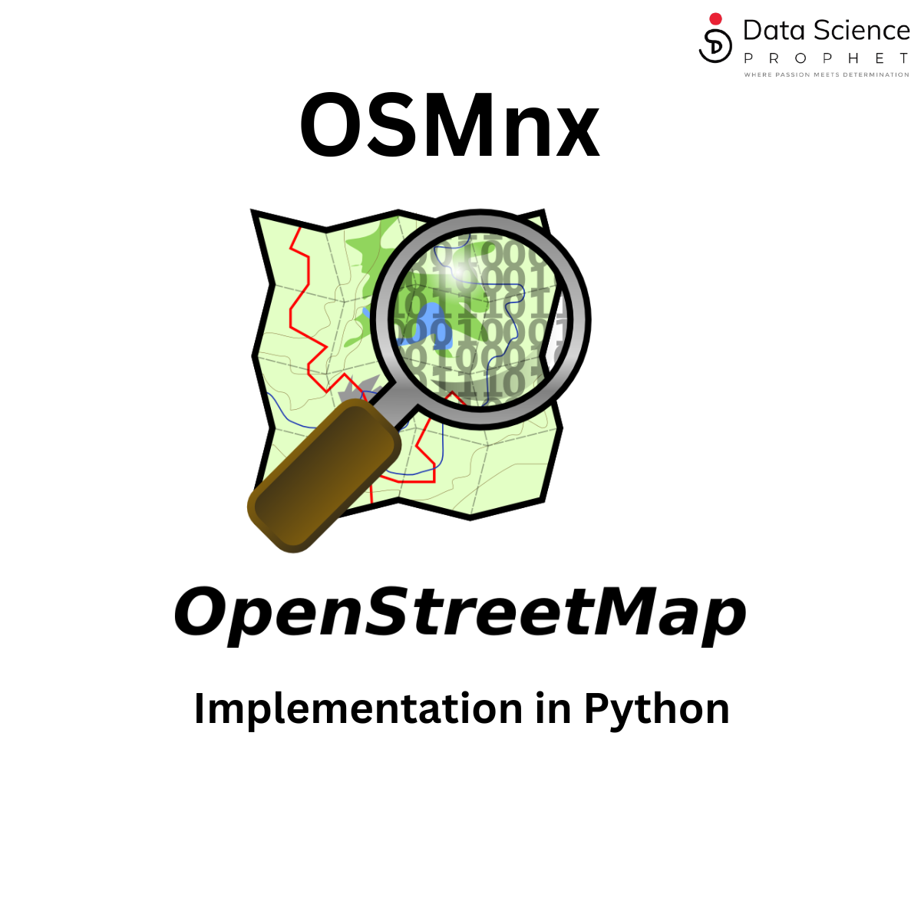


Method & Tools
ArcGIS Pro: Service Area
QGIS: Join attribute by location, Field Calculator, Attribute Table Edit, Layouts
Python:
OSMnx: Network analysis and Data collection
Folium: Interactive visualization
Geopandas: Geospatial data processing
Spatial and mathematical model

Slide 5
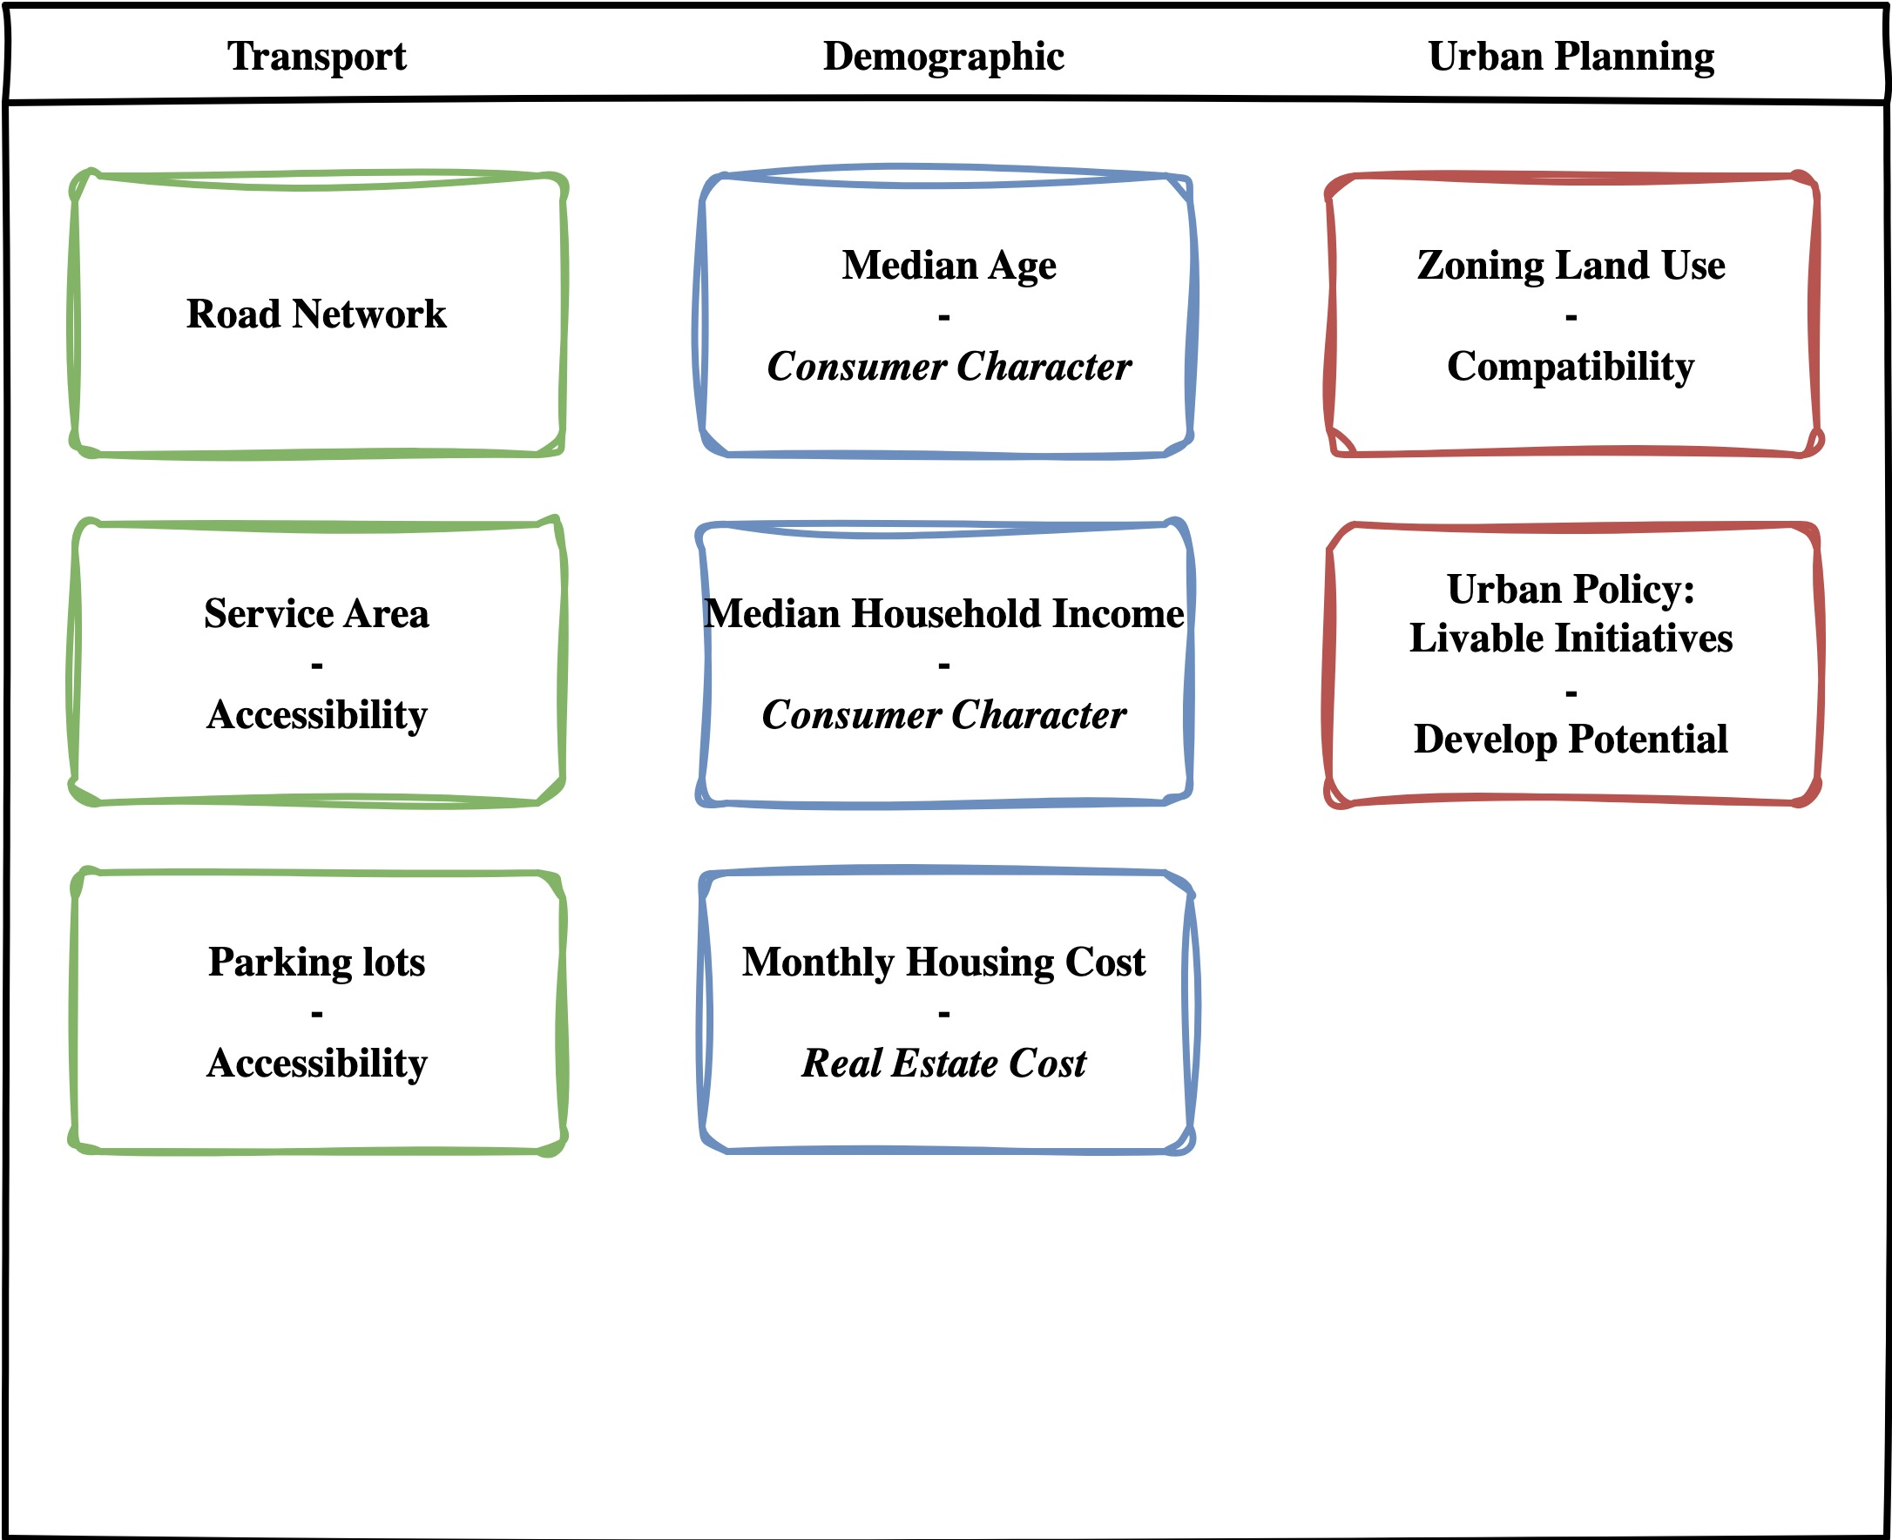



Data
Census tract with housing price, household income, age, race – Census Bureau API
Music venue POI - Yelp API
Parking lot, Road network - OSMX download
Atlanta Neighborhood Area - Course Material
Notes:
Add icons!!!

Slide 6
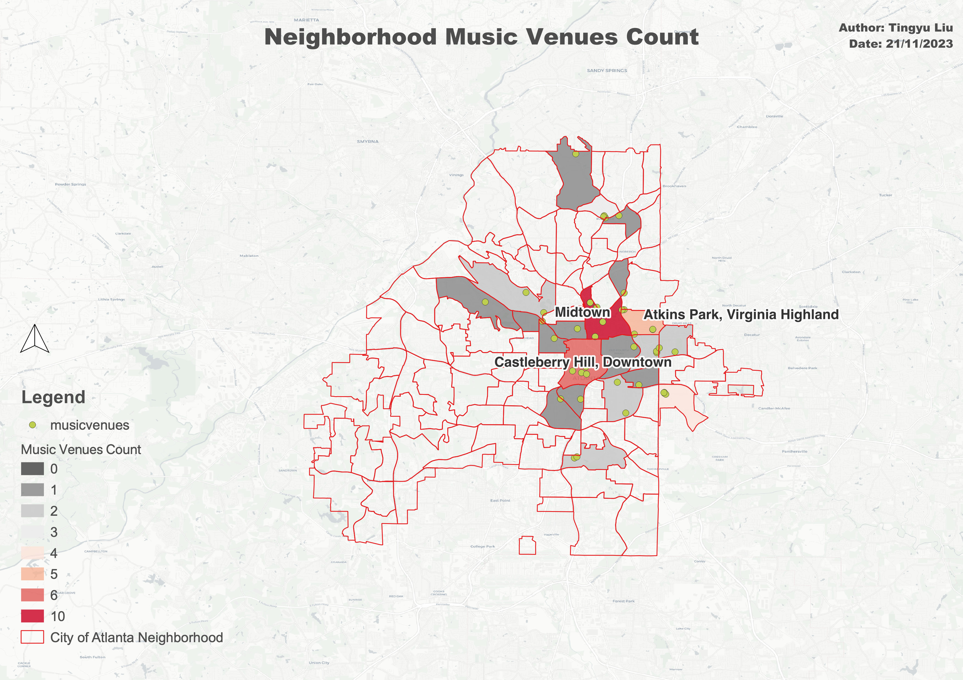
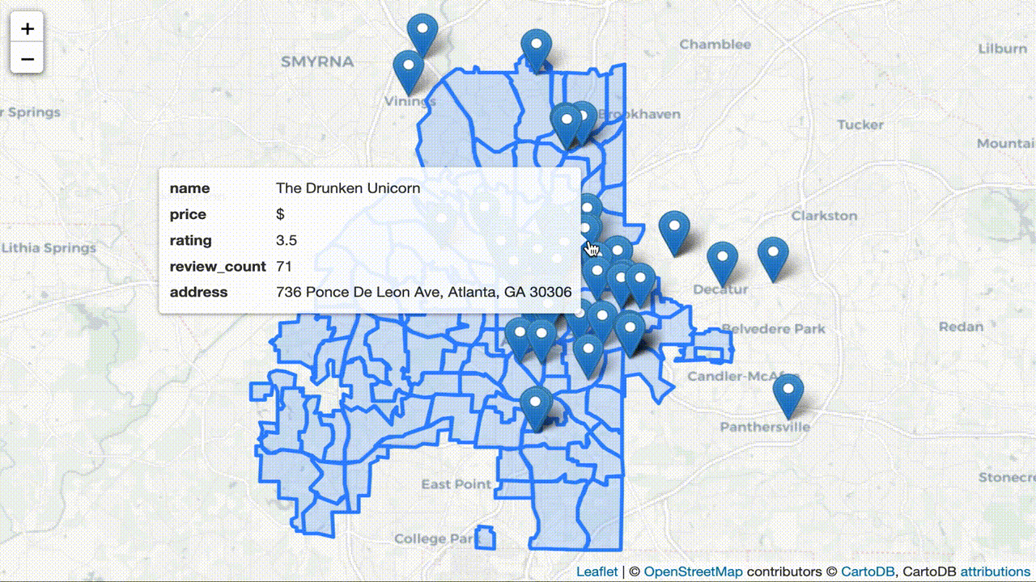
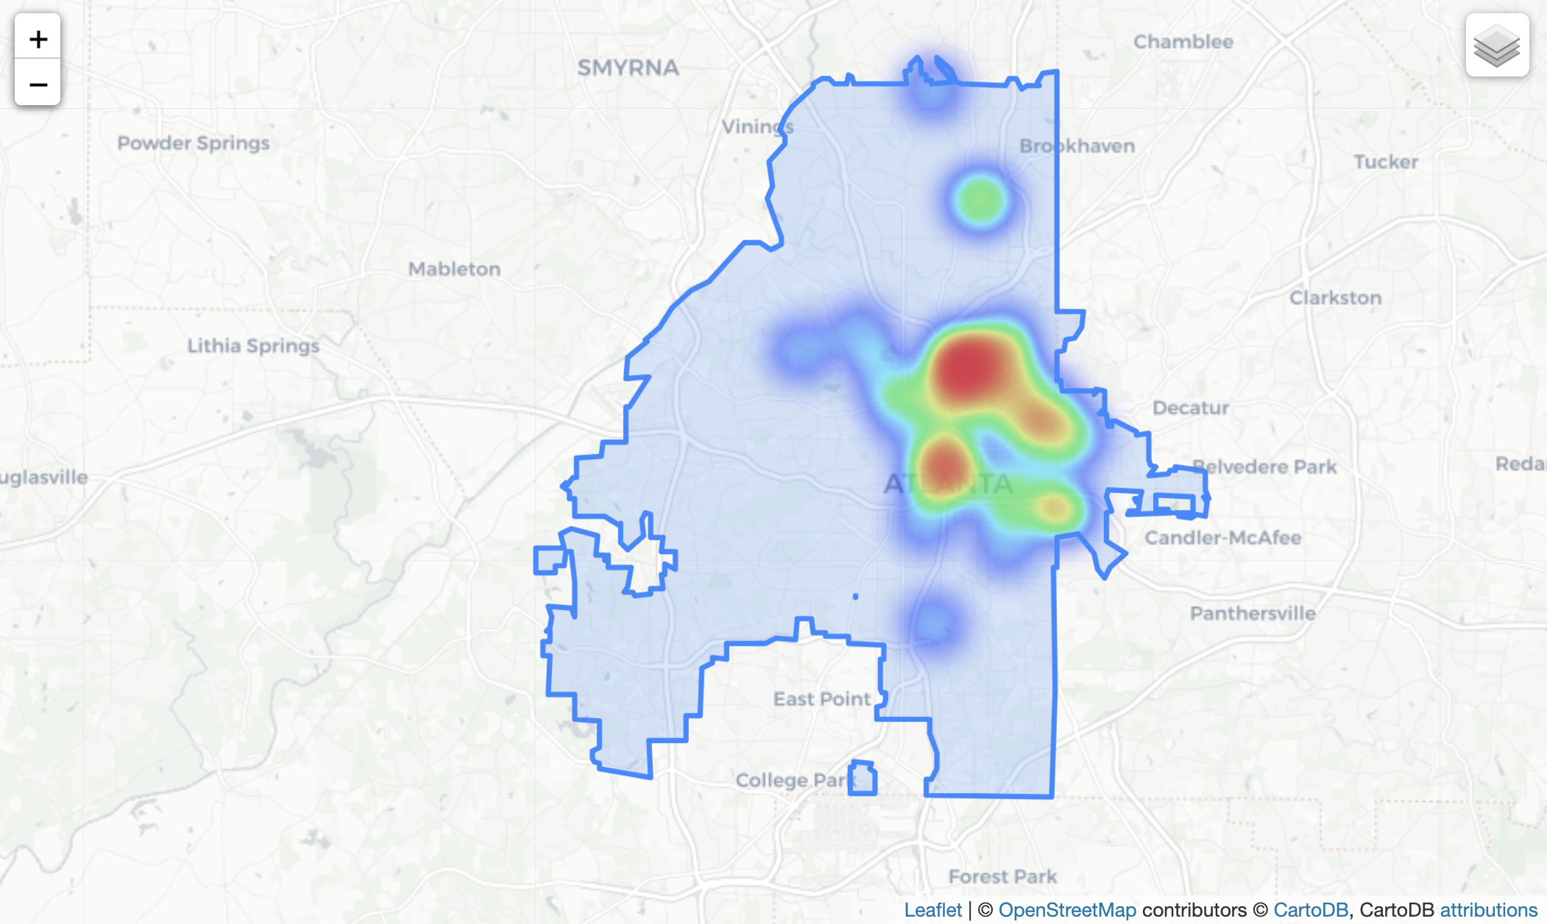
Competitor Analysis: Existing Music Venue
Main text – Navy Roboto 24px.
Example of a sub point. 18px Roboto
Subpoint example
Sub-sub point example the first
And the second

Slide 7
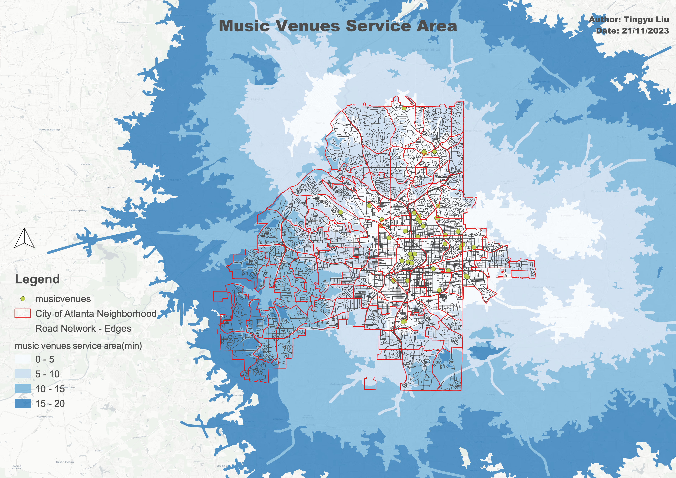
Transport Analysis: Existing Music Venue Service Area
Main text – Navy Roboto 24px.
Example of a sub point. 18px Roboto
Subpoint example
Sub-sub point example the first
And the second

Slide 8
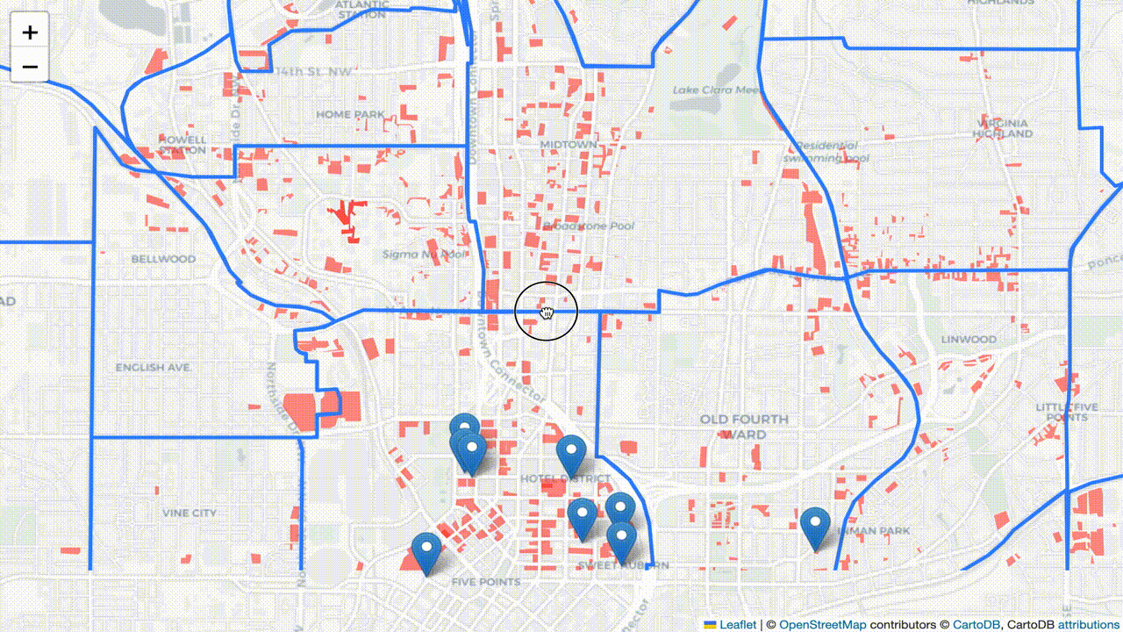
Transport Analysis: Parking Lots Distribution
Main text – Navy Roboto 24px.
Example of a sub point. 18px Roboto
Subpoint example
Sub-sub point example the first
And the second

Slide 9
Demographic Analysis – Who are metalheads?
Metalheads are people who enjoy metal music and regularly attend metal music venues = consumers
- Largely white, cis-gendered, and male.
- Age: Majority age range is 18-34
- Most popular in North America and Northern Europe.
Notes:
The presentation should include your project objectives, the spatial or mathematical model that you built, analysis results, and findings. This will account for 15% of your final grade.

Slide 10
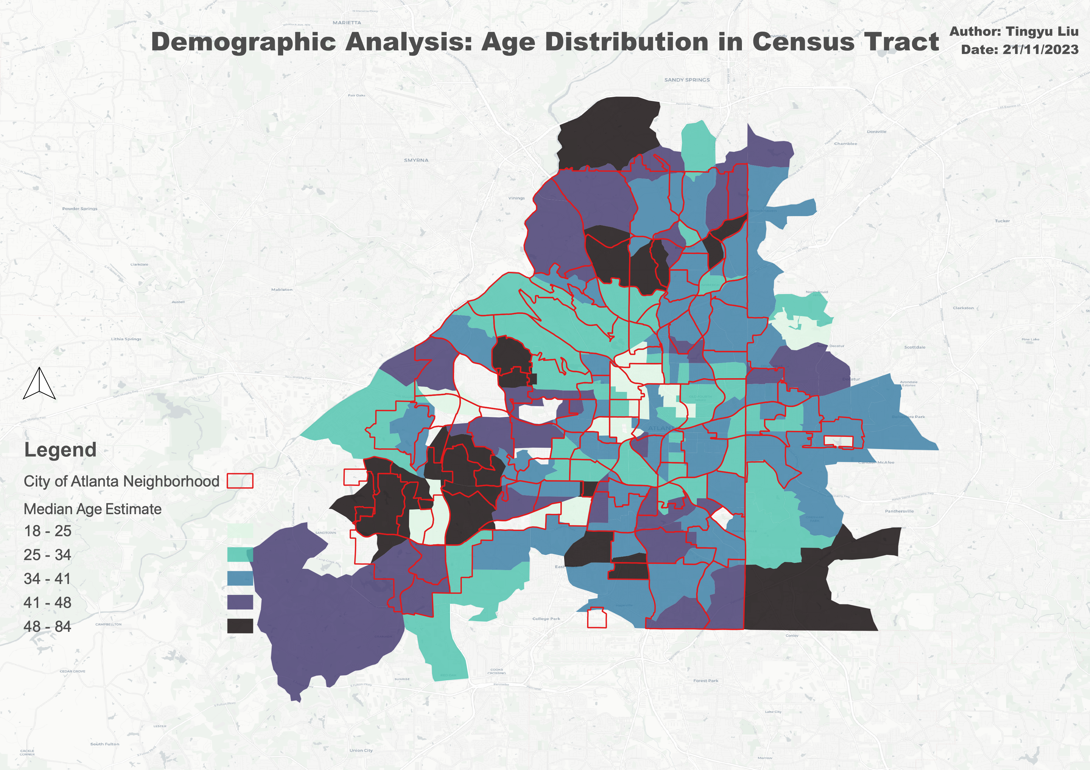
Demographic Analysis – Census Statistics
Key Insights:

Slide 11
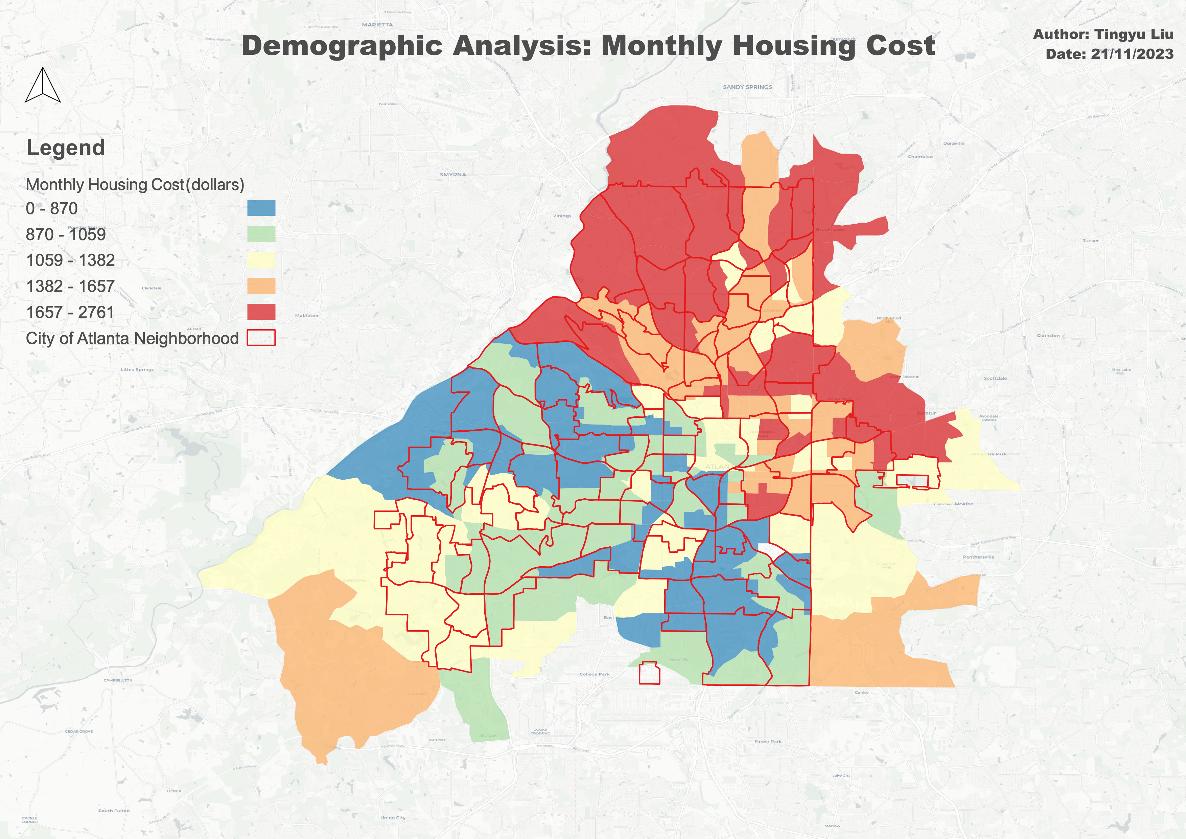
Demographic Analysis – Census Statistics
Key Insights:

Slide 12
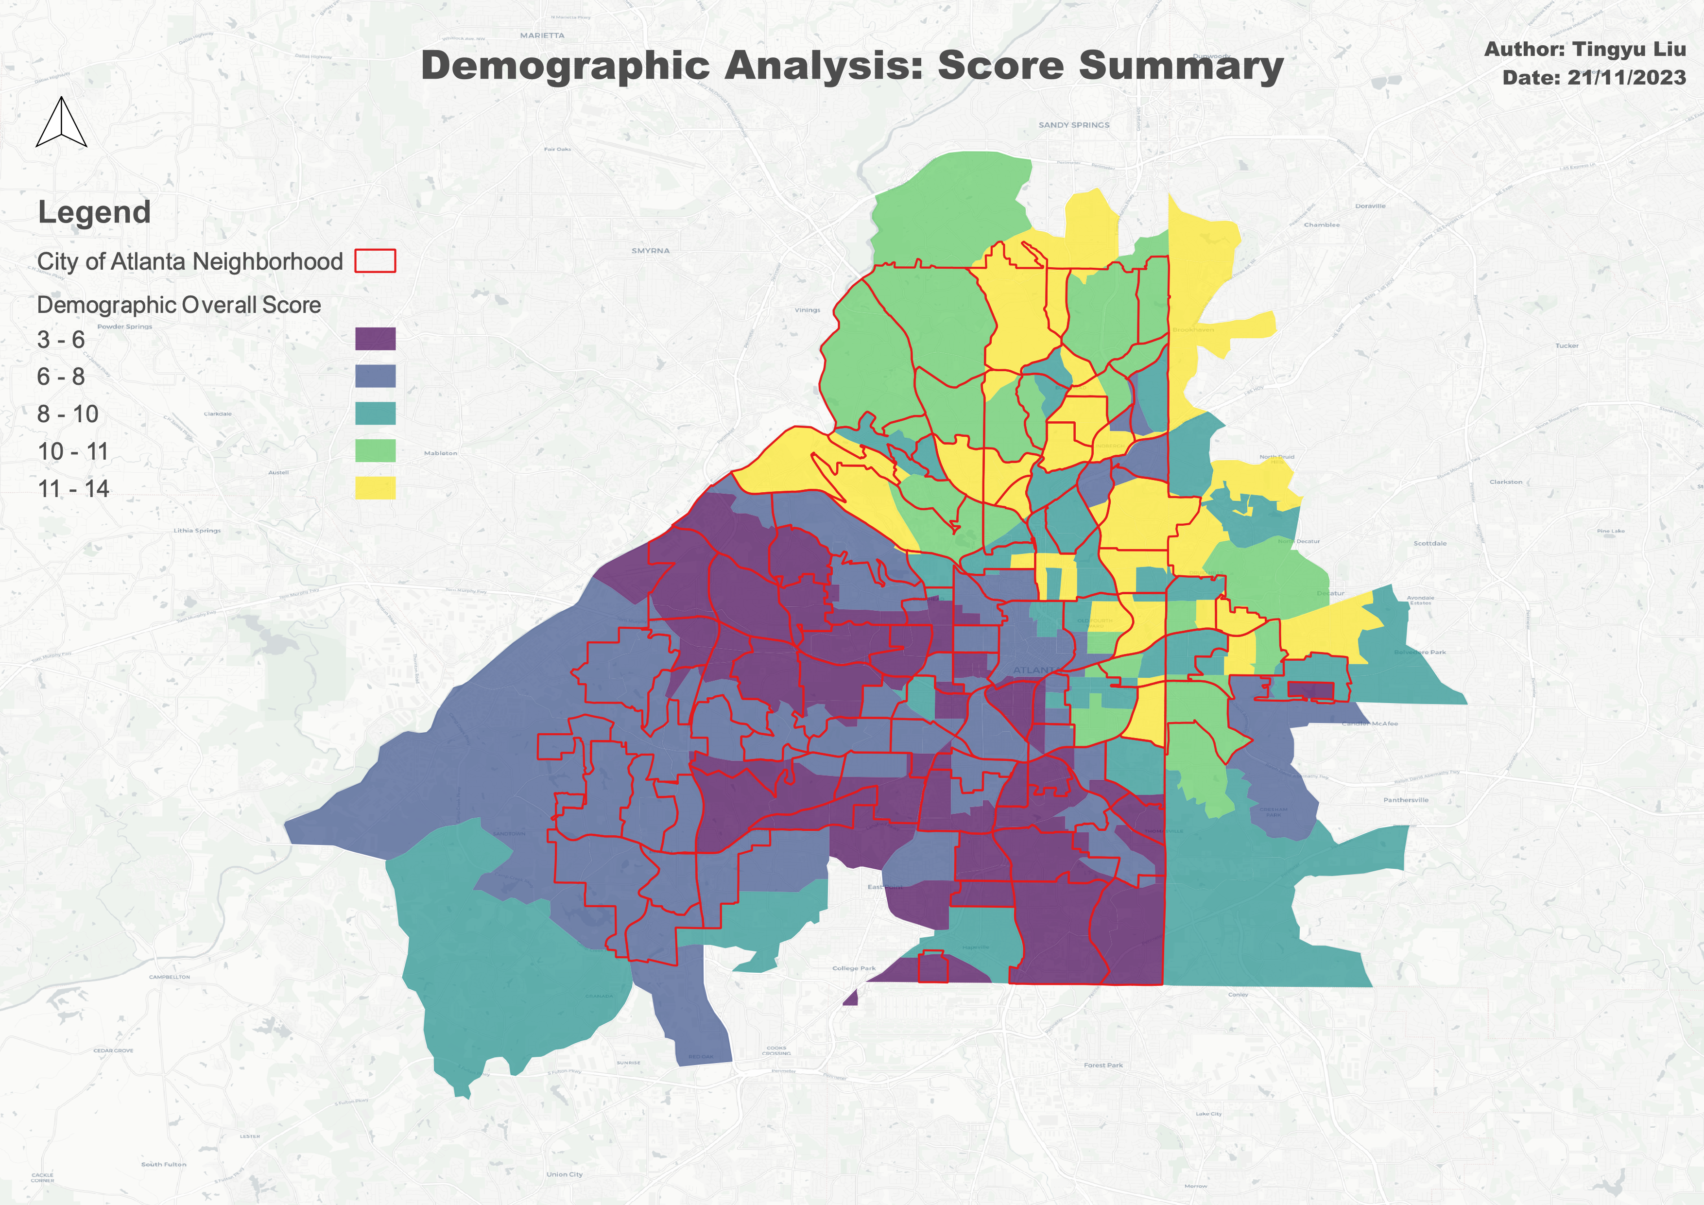
Demographic Analysis – Census Statistics
Key Insights:

Slide 13
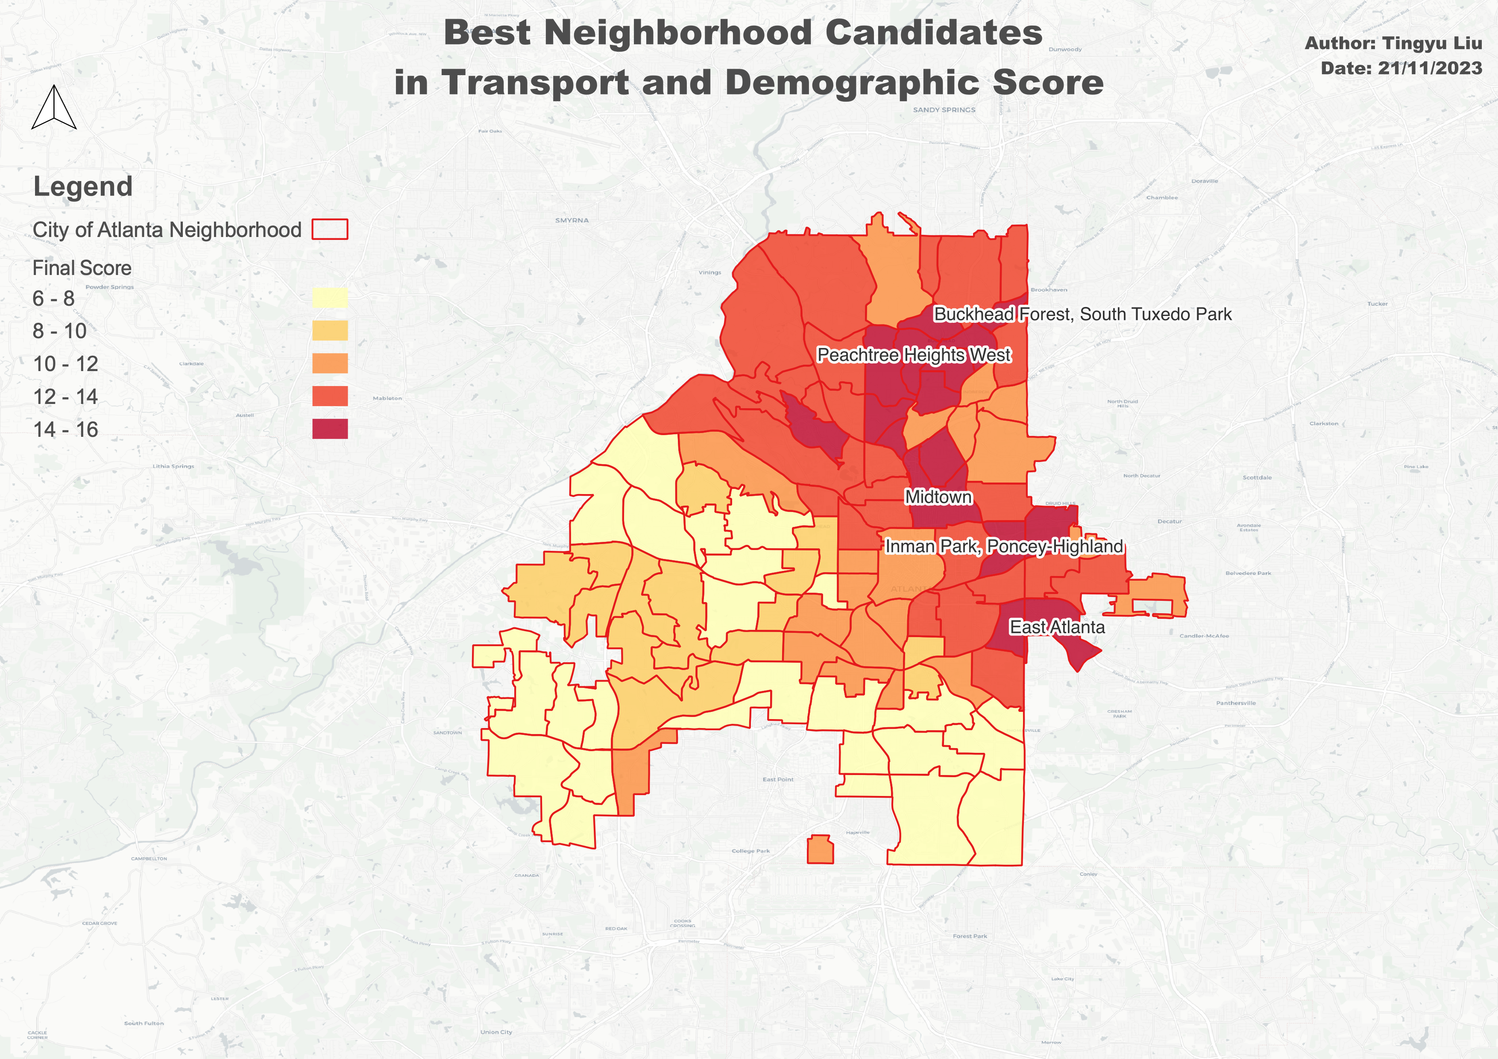
Integrate Transport and Demographic Factors
Key Insights:
Contextual Information:
Main text – Navy Roboto 24px.
Example of a sub point. 18px Roboto
Subpoint example
Sub-sub point example the first
And the second

Slide 14
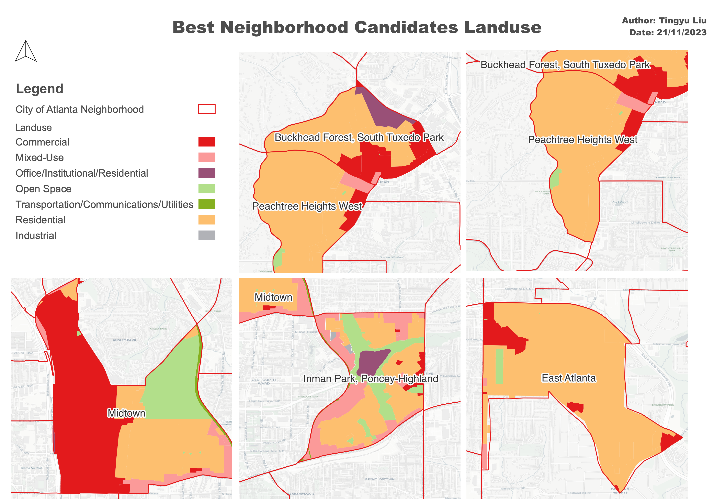
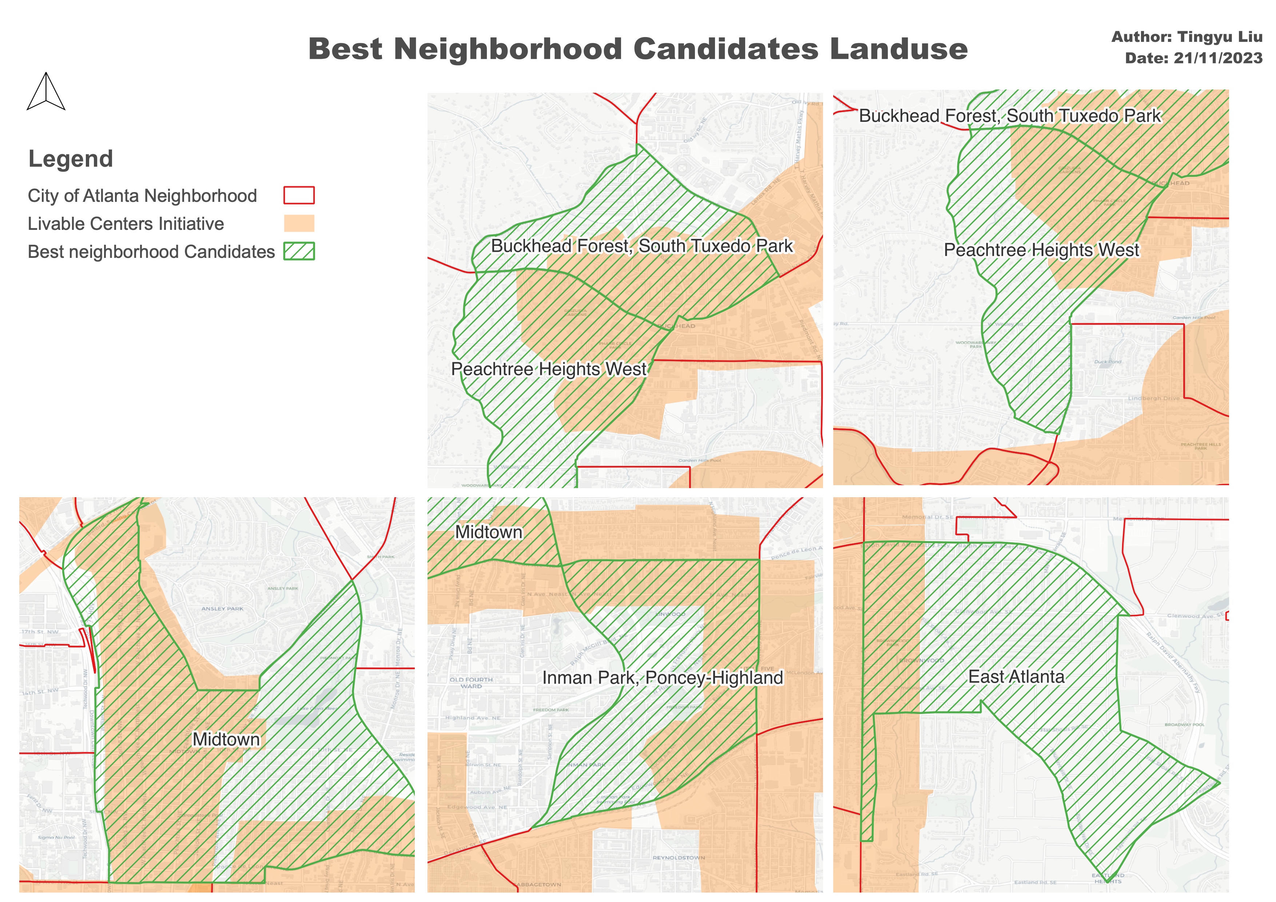
Restrictions: Zoning
Key Insights:
Contextual Information: Created as a way to reduce vehicle miles traveled and improve air quality, the Atlanta Regional Commission’s Livable Centers Initiative (LCI) is a grant program that incentivizes local jurisdictions to re-envision their communities as vibrant, walkable places that offer increased mobility options, encourage healthy lifestyles and provide improved access to jobs and services.

Slide 15
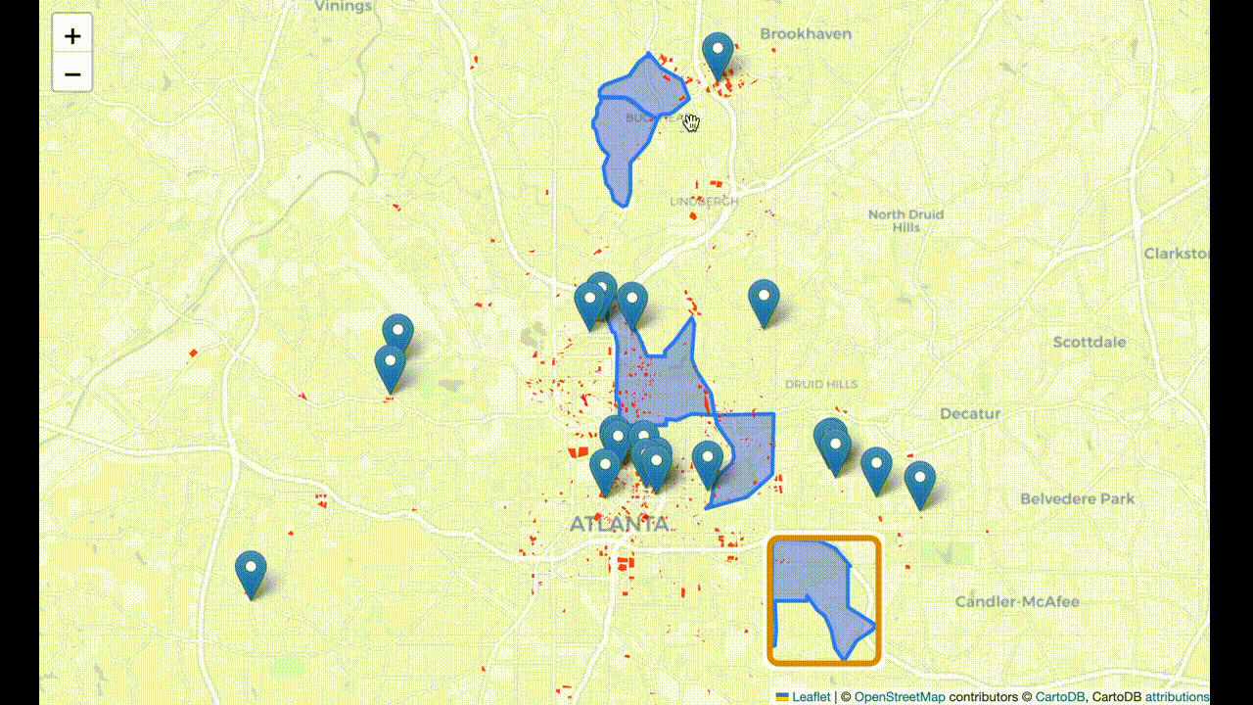
Restrictions: Parking

Slide 16
Integration and Final Selection
Midtown
In-man Park

Slide 17
Conclusion and Discussion
Midtown
In-man Park

Slide 18
Reference
Midtown
In-man Park

Slide 19

Thank you Open to comments and suggestions!

